Slide 1
Sign Language Recognition Using Hand Gestures
Presented By-
Asghar Ali (BSITF18E020)
Khadija Ehsan (BSITF18E048)
Sana Mubeen (BSITF18E034)

Slide 2




Outline
Introduction
Applicability of this project
01
02
Motivation
Problem statement
Practical application
Features
Technologies used
03
04
Conclusion and Future Scope
Working

Slide 3

Introduction
Motivation
1
A person with speaking disorders faces major problems of expressing their emotions as freely in this world.
“Not able to utilize” some of the new technologies.

Slide 4
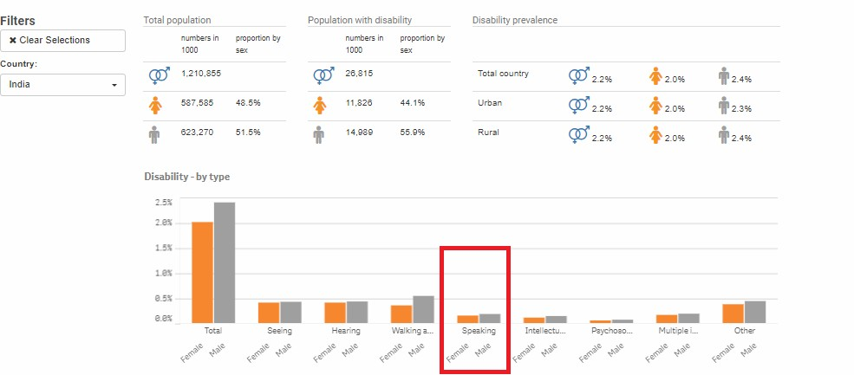
Statistics retrieved from United Nation Statistics Division

Slide 5
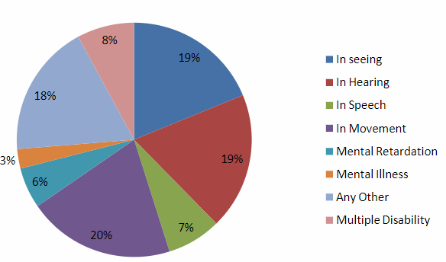
Disabled population by type of disability in Pakistan census 2021

Slide 6
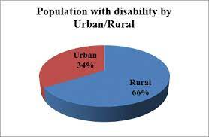
Distribution disabled person in urban/rural areas (%) in Pakistan Census 2021

Slide 7
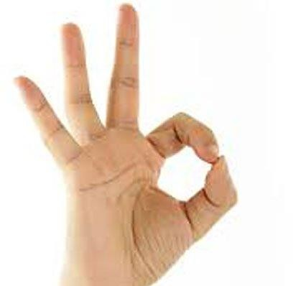
Problem Statement
2
Given a hand gesture, implementing such an application which detects pre- defined Pakistan sign language (PSL) in a real time through hand gestures and providing facility for the user to be able to store the result of the character detected in a txt file, also allowing such users to build their customized gesture so that the problems faced by persons who aren’t able to talk vocally can be accommodated with technological assistance and the barrier of expressing can be overshadowed.

Slide 8

Practical Application
Serves the person who wants to learn and talk in sign languages.
A user need not be a literate person.

Slide 9
Features of this application
Real time (PSL) detection based on gesture made by user.
Customized gesture generation.
Forming a stream of sentences.
TTS assistance mechanisms concerning to the illiterate people.

Slide 10
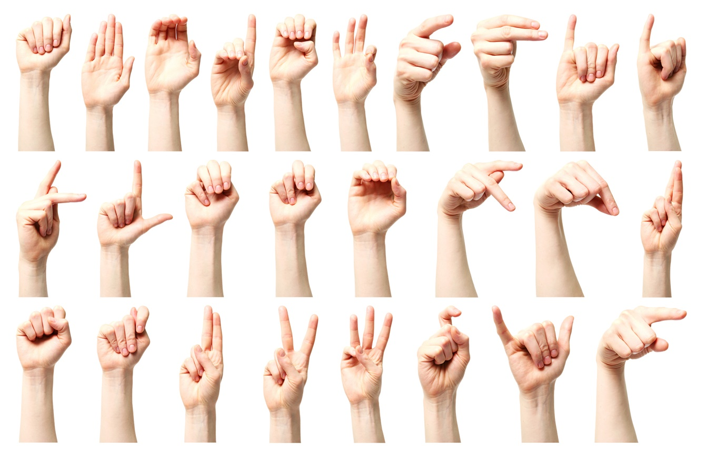

Slide 11







Technologies Used
Python 3.10.
TensorFlow framework, Keras API
Real-time computer vision using OpenCV
Industrial standard GUI application (PyQT5), Tkinter.
Offline TTS assistance for python (pyttsx3 lib)

Slide 12
Core Modules
Data Pre-Processing
Scan Single Gesture
Create gesture
Formation of sentence
Exporting

Slide 13
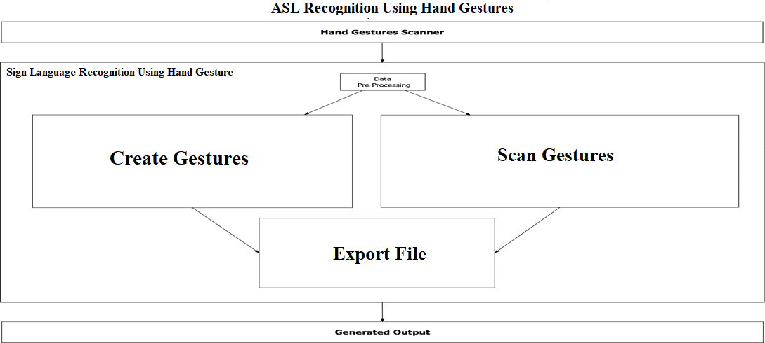
Hand Gesture Scanner

Slide 14
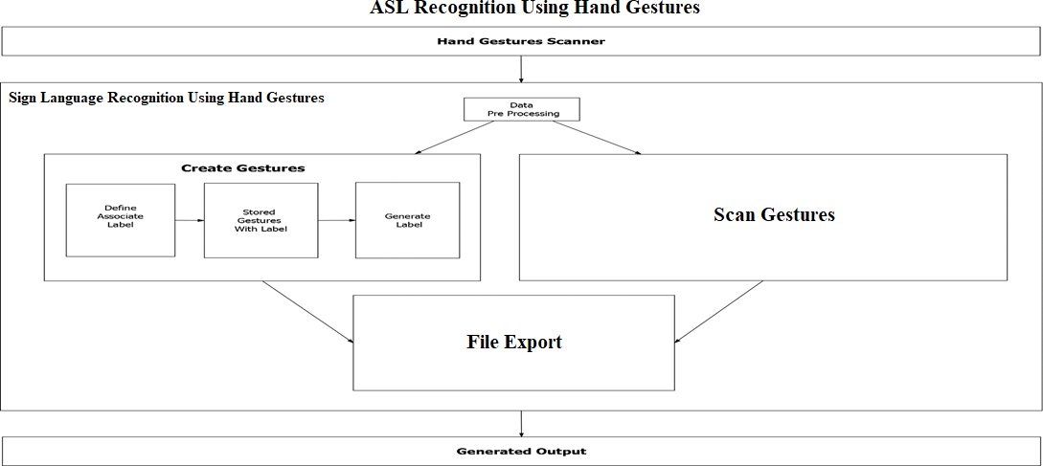
Hand Gesture Scanner

Slide 15
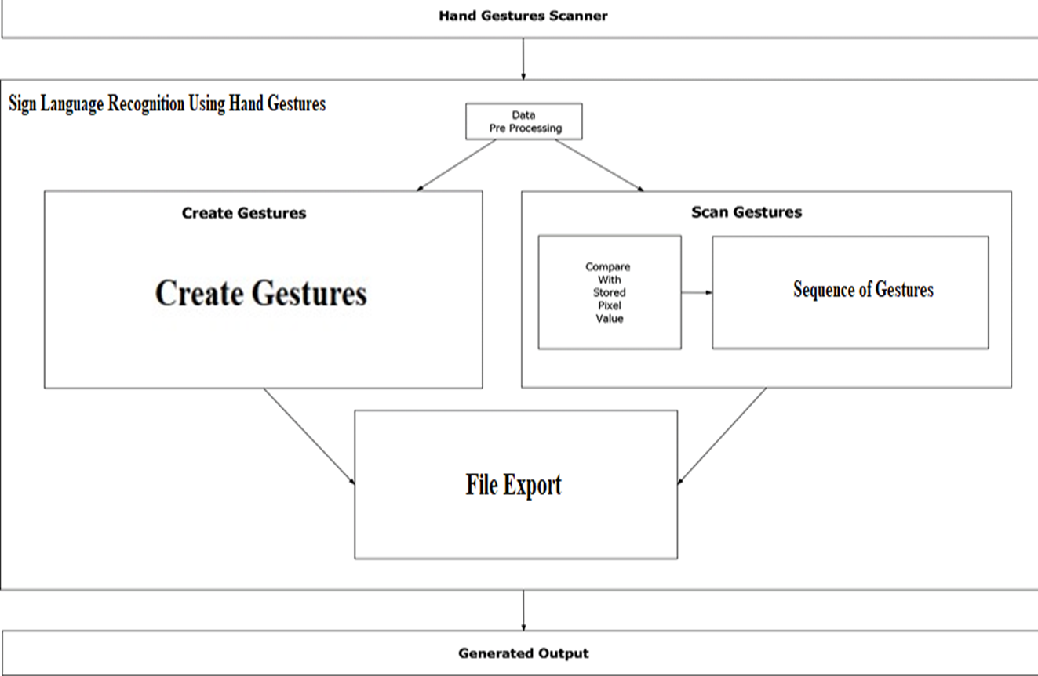
PSL Recognition Using Hand Gestures

Slide 16
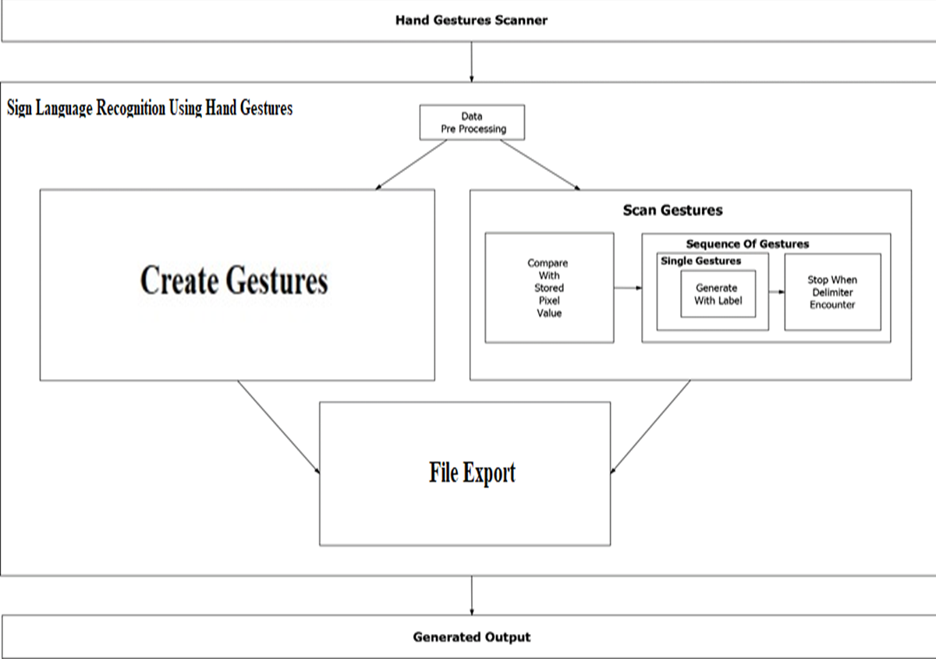
PSL Recognition Using Hand Gestures

Slide 17
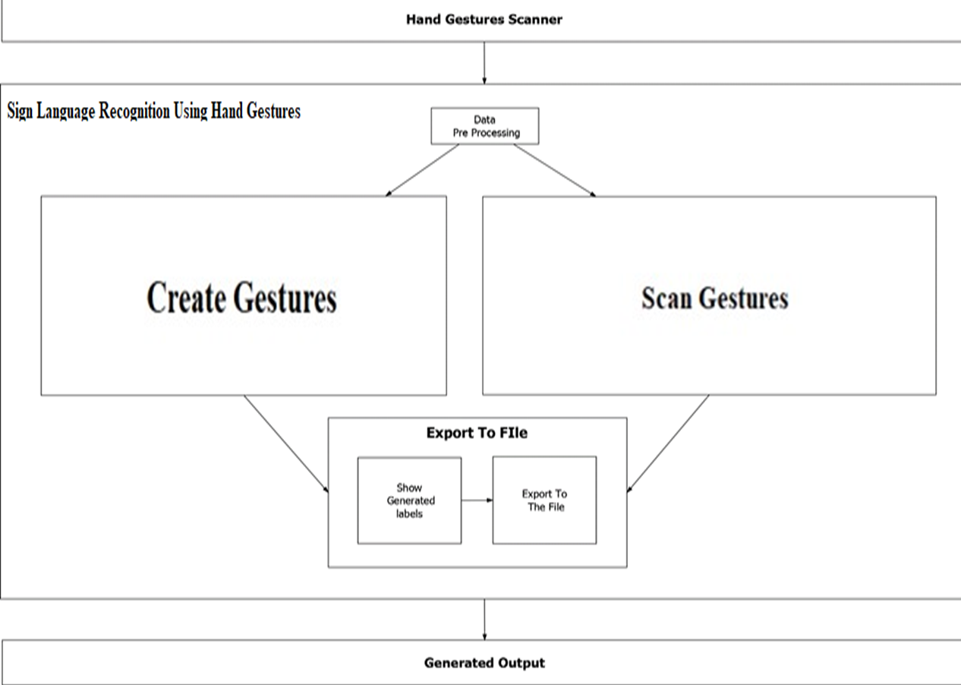
PSL Recognition Using Hand Gestures

Slide 18
Conclusion
Overshadowing some of the major problems faced by the persons having speech disorders.
They can quickly learn what alphabet is assigned to which gesture with this application.
Add-on to this custom gesture facility is also provided along with sentence formation.

Slide 19
Future Scope
Integration to search engines and texting application.
Detection of motion video sequence with TTS assistance.

Slide 20
THANK YOU!

